Slide 1

Primetime Network Programming: A workshop on Deep Neural Networks in Ultrasound Beamforming
Brett Byram and Jaime Tierney
AIUM Workshop—2020
Download code: https://github.com/VU-BEAM-Lab/DNNBeamforming

Slide 2
The Use of Neural Networks in Ultrasound Beamforming
Brett Byram and Jaime Tierney
AIUM Workshop—2020

Slide 3

Motivating Deep Networks from classic ideas that we all feel good about
1.) Estimation Theory
2.) Curve Fitting

Slide 4
Estimation Theory

Slide 5

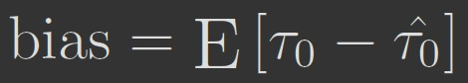
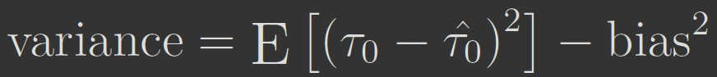
Biased Estimation
How far is the target?

Slide 6
Curve Fitting

Slide 7
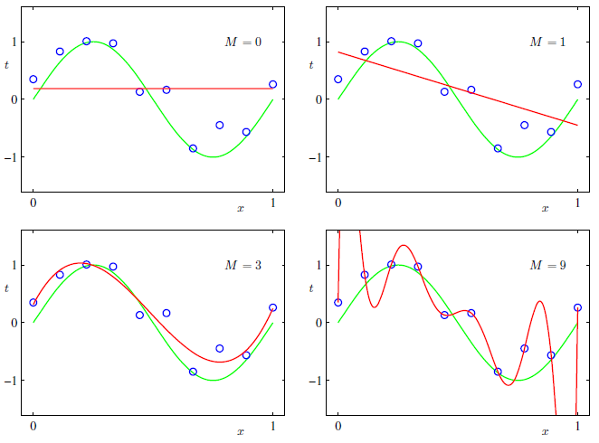
Choose bases:
Sinusoids (e.g. Fourier Transforms)
Polynomials
Bessel functions
Custom functions (e.g. ADMIRE¹)
¹B. Byram et al., "A model and regularization scheme for ultrasonic beamforming clutter reduction," in IEEE UFFC, vol. 62, no. 11, pp. 1913-1927, 2015
Common Problems:
Many classic strategies to overcome these problems
—regularization
—acquire more data
—choose different bases
—etc.
Demonstration of DNNs as curve fitting: http://neuralnetworksanddeeplearning.com/chap4.html

Slide 8
Deep Network Tutorial

Slide 9
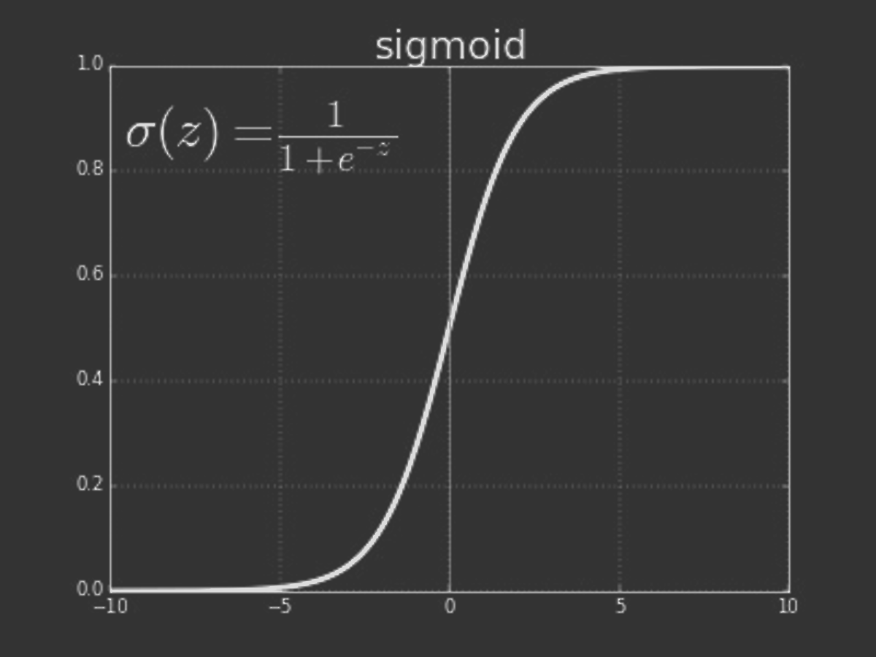
Simple Neuron
x₁
w₁
x₂
w₂
Σ
f(.)
y₁
_{b}
y₁=f(x_{1 *}w₁+ x_{2 *}w₂+b)

Slide 10

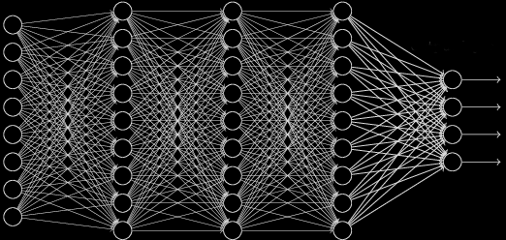
Deep Neural Network
Input (x)
…
Output (y)
…
p₁=f(W₁ x+b₁)
y=f(W_{n} p_{n-1} +b_{n})

Slide 11
Deep Neural Network
So, how do we get all the weights and biases?
Input (x)
…
Output (y)
…
p₁=f(W₁ x+b₁)
y=f(W_{n} p_{n-1} +b_{n})

Slide 12



Deep Neural Network
Input (x)
…
Output (y)
$$E={Σ\left\|y−\hat{y}\right\|}_{2}^{2}$$
The Backpropagation Algorithm:
1.) Propagate input data (x) through the network
2.) Compare the output ($\hat{y}$) to the desired output ($y$)
3.) Update the weights and biases to minimize the
error ($E={Σ\left\|y−\hat{y}\right\|}_{2}^{2}$)
Update Equation:
$w=w−α\frac{∂E}{∂w}$

Slide 13
Deep Neural Network
1.)
Input (x)
…
Output (y)
$$E={Σ\left\|y−\hat{y}\right\|}_{2}^{2}$$
The Backpropagation Algorithm:
1.) Propagate input data (x) through the network
2.) Compare the output ($\hat{y}$) to the desired output ($y$)
3.) Update the weights and biases to minimize the
error ($E={Σ\left\|y−\hat{y}\right\|}_{2}^{2}$)
Update Equation:
$w=w−α\frac{∂E}{∂w}$

Slide 14
Deep Neural Network
1.)
2.)
Input (x)
…
Output (y)
$$E={Σ\left\|y−\hat{y}\right\|}_{2}^{2}$$
The Backpropagation Algorithm:
1.) Propagate input data (x) through the network
2.) Compare the output ($\hat{y}$) to the desired output ($y$)
3.) Update the weights and biases to minimize the
error ($E={Σ\left\|y−\hat{y}\right\|}_{2}^{2}$)
Update Equation:
$w=w−α\frac{∂E}{∂w}$

Slide 15
Deep Neural Network
1.)
2.)
Input (x)
…
Output (y)
3.)
$$E={Σ\left\|y−\hat{y}\right\|}_{2}^{2}$$
The Backpropagation Algorithm:
1.) Propagate input data (x) through the network
2.) Compare the output ($\hat{y}$) to the desired output ($y$)
3.) Update the weights and biases to minimize the
error ($E={Σ\left\|y−\hat{y}\right\|}_{2}^{2}$)
Update Equation:
$w=w−α\frac{∂E}{∂w}$

Slide 16
Deep Neural Network
1.)
2.)
Input (x)
…
Output (y)
3.)
$$E={Σ\left\|y−\hat{y}\right\|}_{2}^{2}$$
The Backpropagation Algorithm:
1.) Propagate input data (x) through the network
2.) Compare the output ($\hat{y}$) to the desired output ($y$)
3.) Update the weights and biases to minimize the
error ($E={Σ\left\|y−\hat{y}\right\|}_{2}^{2}$)
Update Equation:
$w=w−α\frac{∂E}{∂w}$
We have to start somewhere… so we initialize weights randomly

Slide 17
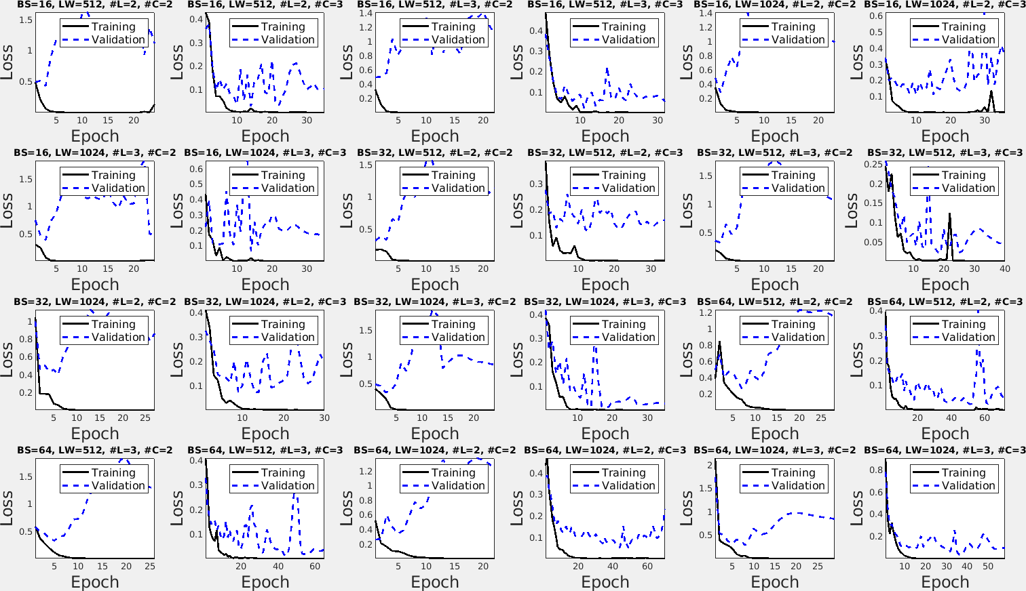
Deep Neural Network Training
Training Time Data
Test Time Data
Training Data (~60%)
Test Data (~20%)
Validation
Data (~20%)
Pairs of x,y data
1.) Select subset of training data (a batch) and update
weights
2.) Complete an epoch, which is once through all the
training data
3.) Compute validation error at the end of each epoch
4.) Compute test error once at the very end (possibly after
training multiple networks)
Good
Bad
Training Time Loss Curves

Slide 18
Network Design Choices

Slide 19
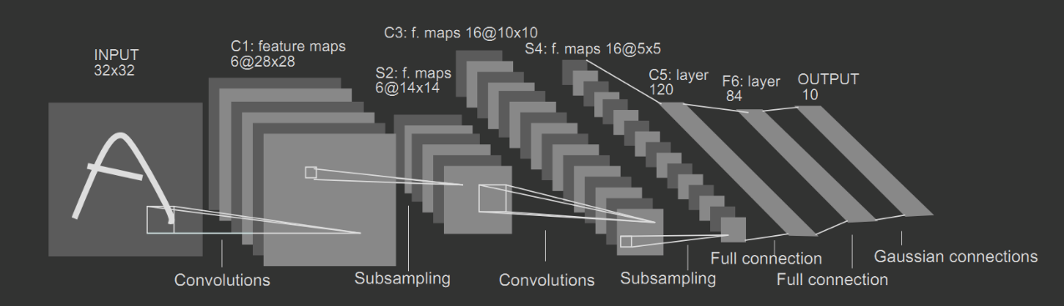
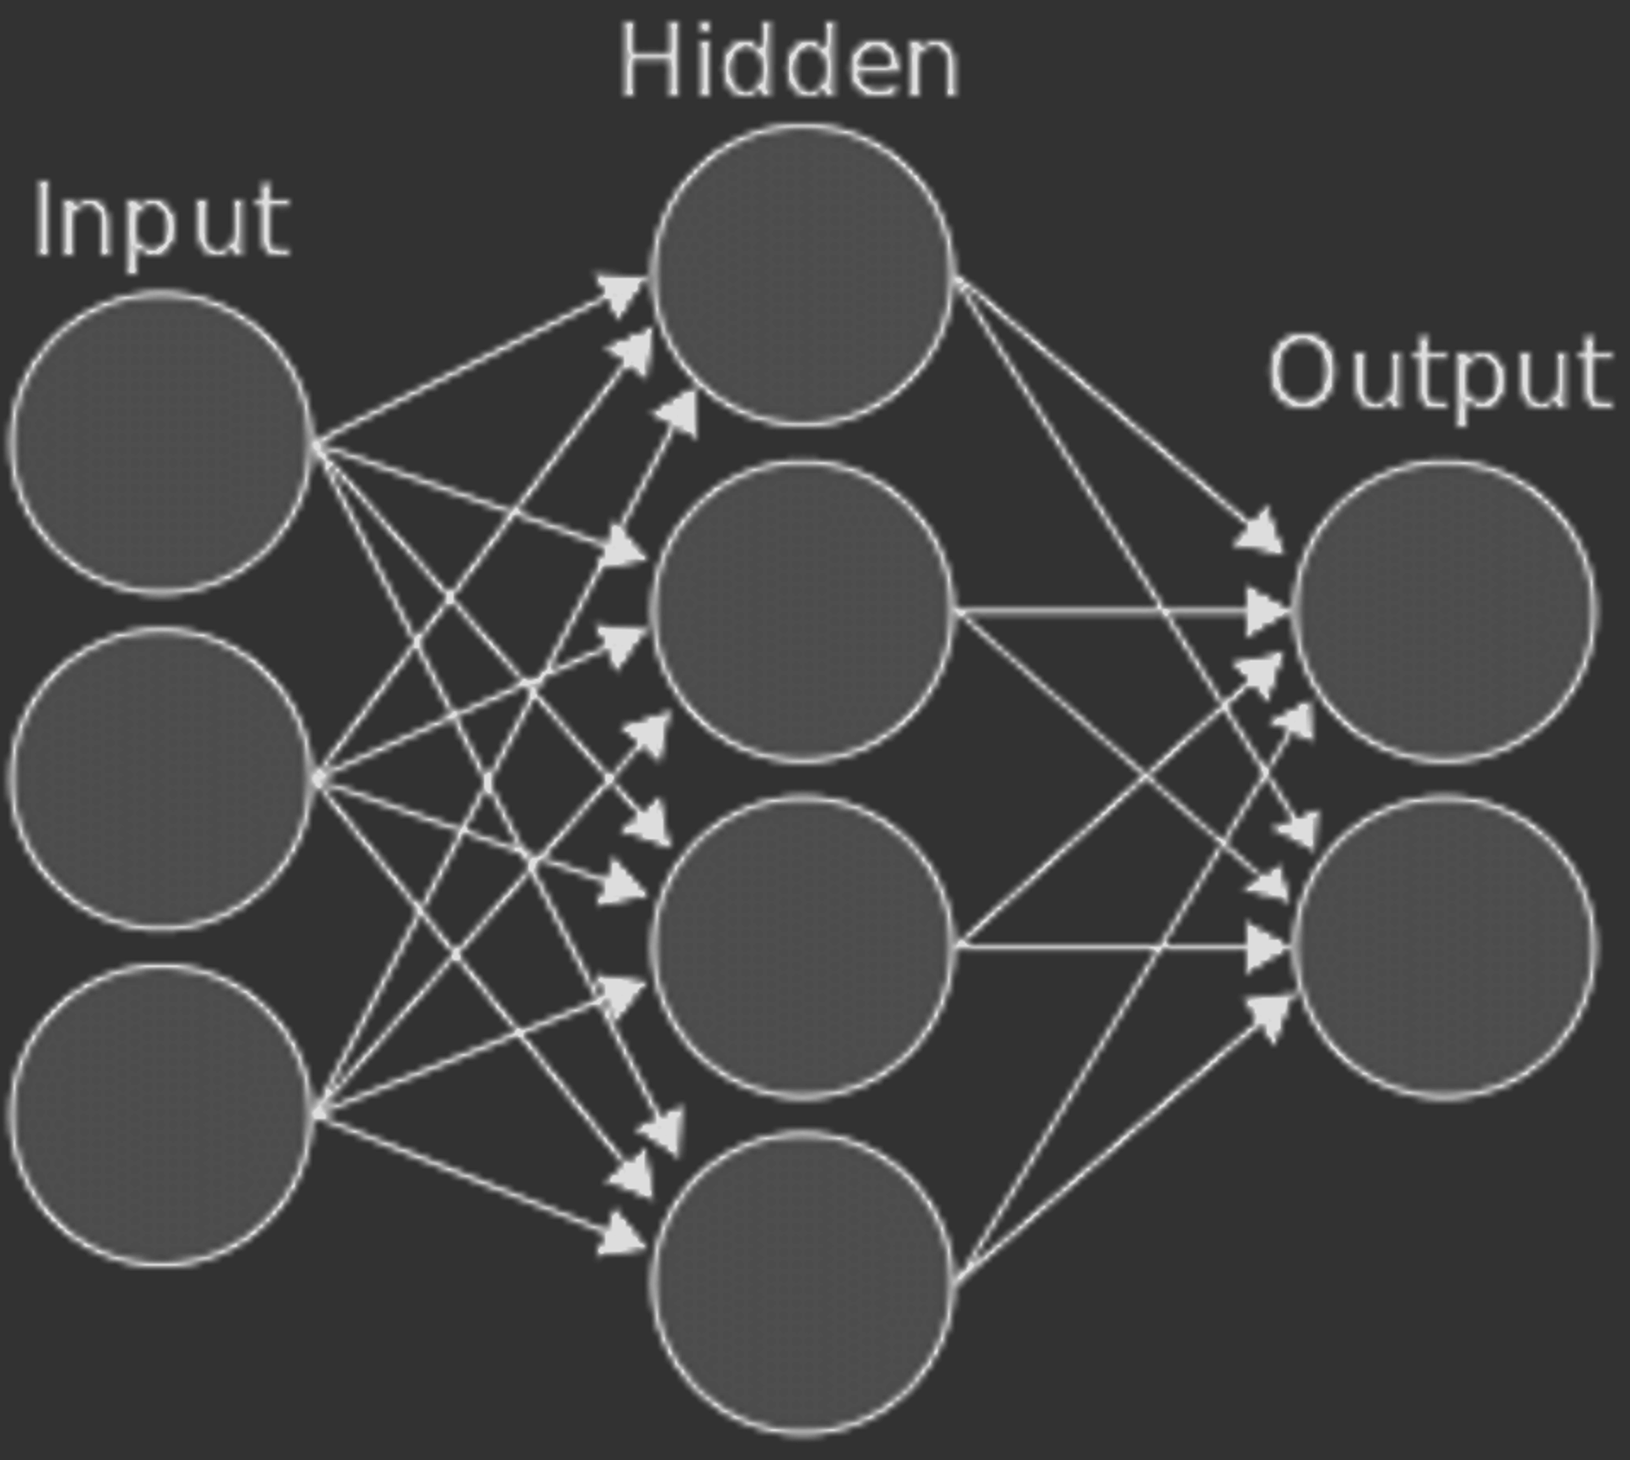
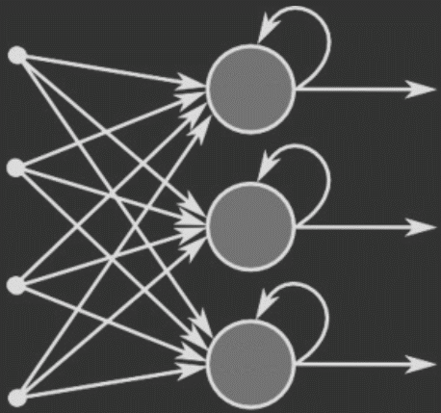
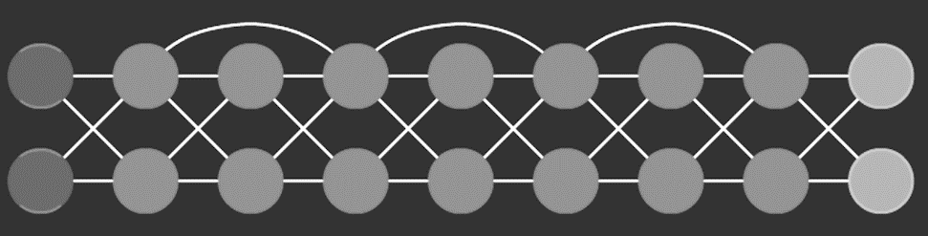
Some Common Deep Network Architectures
Convolutional Neural Network
Fully Connected Network
(https://pythonmachinelearning.pro)
Recurrent Neural Network
Time dependence
(https://www.researchgate.net)
Residual Networks
(https://nerdthecoder.wordpress.com)
Skip connections
(http://primo.ai/)
Also, Generative Adversarial Networks

Slide 20
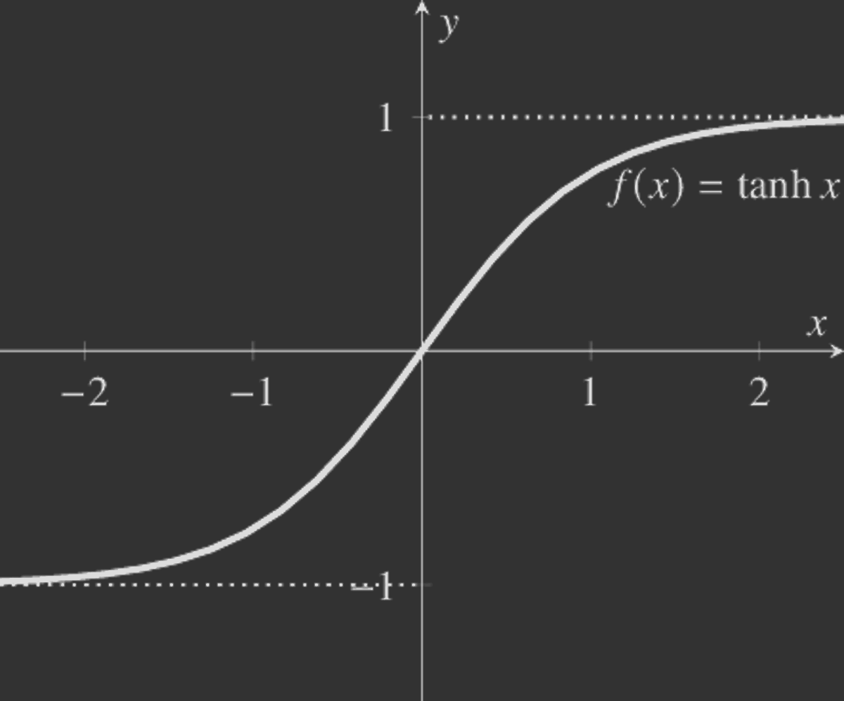
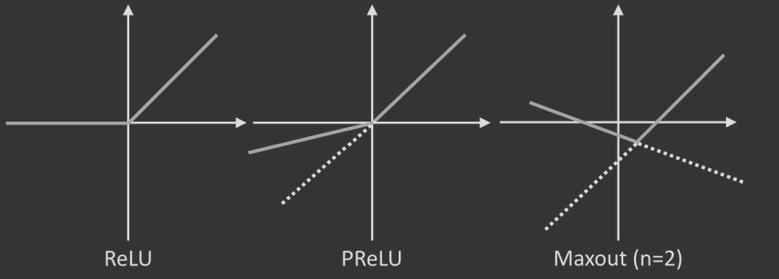
Activation Functions
Sigmoid
Hyperbolic Tangent
Rectified Linear Unit (ReLU)
Maxout

Slide 21
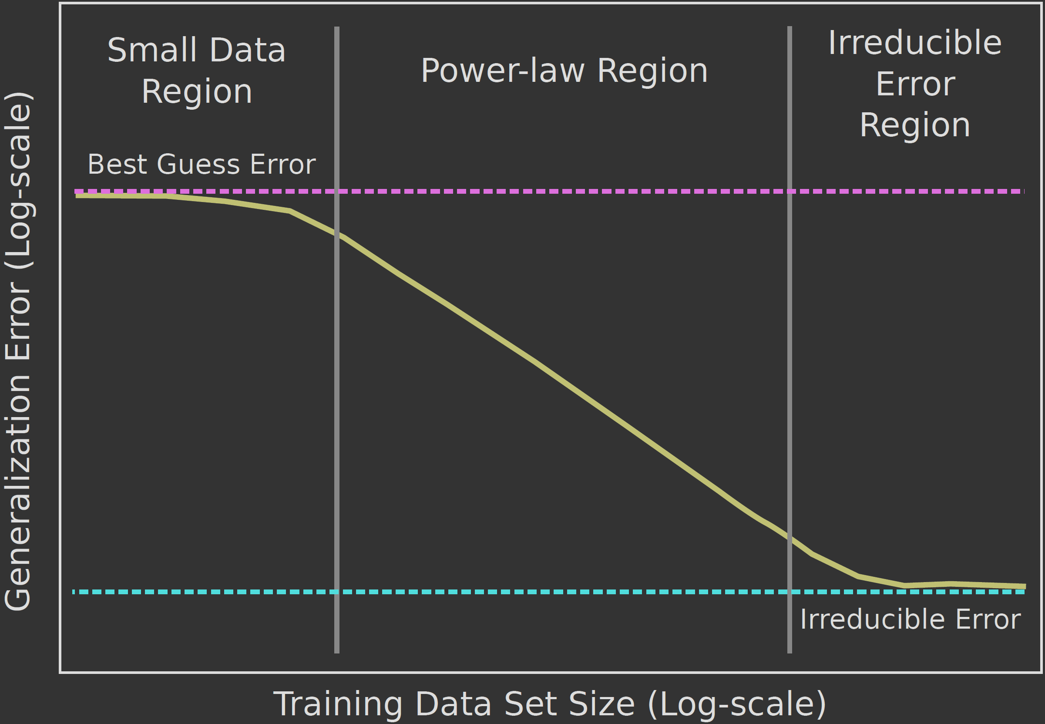
Data and Architectures
Architecture moves this curve up and down
Fig. 6 from Hestness et al., “Deep Learning Scaling is Predictable, Empirically.” arXiv, 2017. (https://arxiv.org/abs/1712.00409v1)

Slide 22
Training strategies are also part of design

Slide 23

Training and hyperparameter searches
Network architecture gets a lot of visibility, but training methods and hyperparameter searches are just as important
$w=w−α\frac{∂E}{∂w}$
Key parameters for effective training include the following:
—Learning rate
—Optimization routine
—Weight dropout during training
—Weight regularization
—Batch Size (i.e. how much data to include at a time)
—Learning rate
A broader hyperparameter search may also include:
—The loss function
—Activation function
—Network structure (e.g. number of hidden layers, layer
width, etc.)

Slide 24
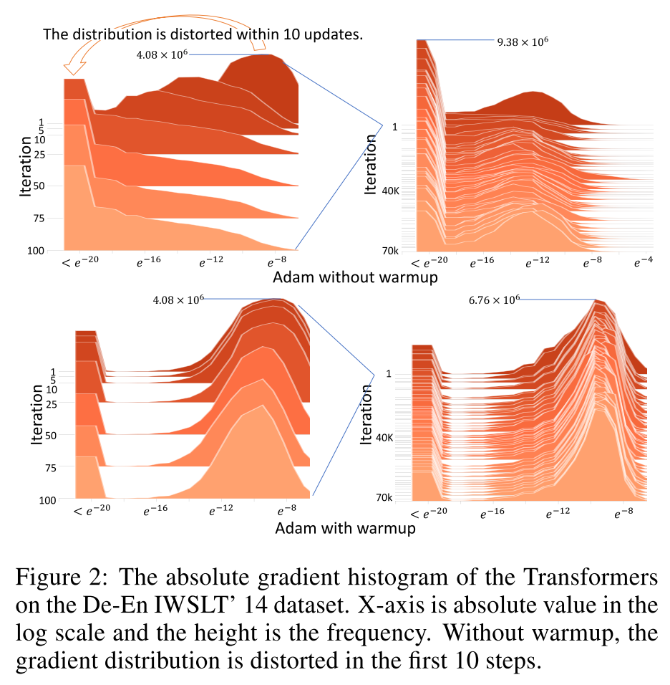
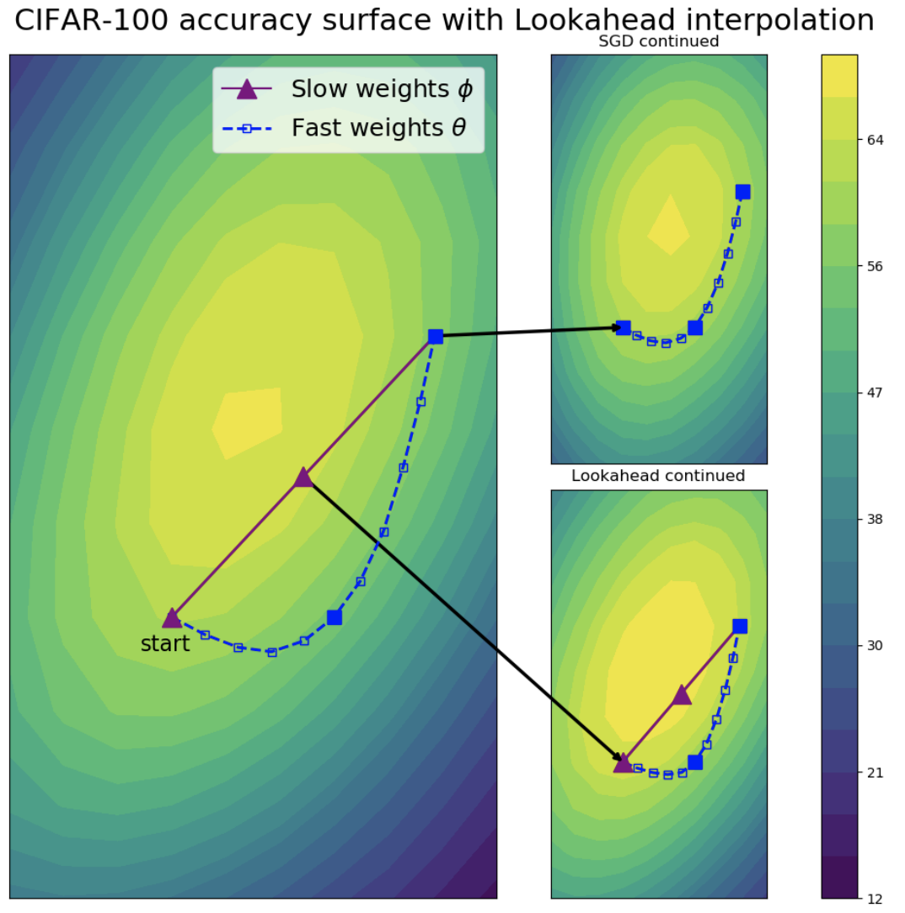
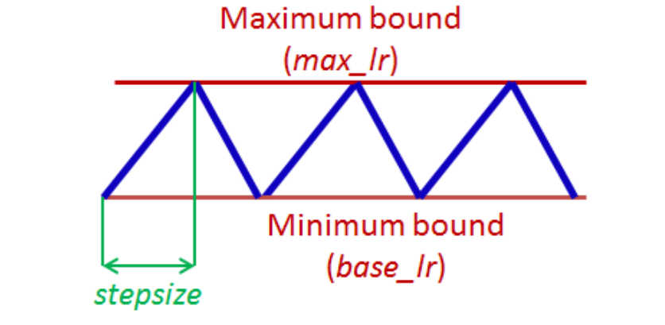
Improved Optimization Routines
“Rectified” Adam
Look Ahead
Liu, L., Jiang, H., He, P., Chen, W., Liu, X., Gao, J., Han, J. (2019). “On the variance of adaptive learning rate and beyond”. arXiv preprint arXiv:1908.03265. pp. 1-14.
Zhang, M. R. Lucas, J., Hinton, G., Ba, J. (2019) Lookahead optimizer: k steps forward, one step back. arXiv preprint arXiv:1907.08610. pp 1-16.
Cyclical Learning Rate
Smith, L. (2017). “Cyclical learning rates for training neural networks”. Proceedings of the IEEE Winter Conference on Applications of Computer Vision. Pp 464-472.

Slide 25
Data

Slide 26
Data and Architectures
Last key thing… is picking the right data to go in and out
Input (x)
…
Output (y)

Slide 27
Some deep network resources people have found useful* —Andrew Ng’s Machine Learning Course (https://www.coursera.org/learn/machine-learning) — Andrew Ng’s Deep Learning Course (https://www.coursera.org/learn/neural-networks-deep-learning) — IBM’s Deep Neural Networks with PyTorch (https://www.coursera.org/learn/deep-neural-networks-with- pytorch) — Youtube video on Deep Learning and Neural Networks with Python and PyTorch (https://youtu.be/BzcBsTou0C0) — fast.ai course and resources (https://www.fast.ai/about/) — Deep Learning by Ian Goodfellow (https://www.deeplearningbook.org/) — Course Notes from Stanford’s CS 231 course (http://cs231n.stanford.edu) — Deep Neural Networks and Deep Learning by Michael Nielsen (http://neuralnetworksanddeeplearning.com) *This list represents resources people that I know have used and recommended with an emphasis on coming up to speed. It is not exhaustive. There are many, many excellent resources.

Slide 28
Deep Network Beamforming

Slide 29
DNN Beamforming Strategies
Ground Truth Target
Better Beamformer Target
⁵Luchies and Byram. "Deep neural networks for ultrasound beamforming." IEEE TMI 37.9 (2018): 2010-2021.
⁶Dongwoon, et al. "Beamforming and speckle reduction using neural networks." IEEE TUFFC 66.5 (2019): 898-910.
⁷Nair, et al. "Deep learning to obtain simultaneous image and segmentation outputs from a single input of raw ultrasound channel data." IEEE TUFFC (2020).
⁸Zhuang and Chen. "Deep learning based minimum variance beamforming for ultrasound imaging." Smart Ultrasound Imaging and Perinatal, Preterm and Paediatric Image Analysis. Springer, Cham, 2019. 83-91.
⁹Gasse, et al. "High-quality plane wave compounding using convolutional neural networks." IEEE TUFFC 64.10 (2017): 1637-1639.
¹⁰Zhou, et al. "High spatial–temporal resolution reconstruction of plane-wave ultrasound images with a multichannel multiscale convolutional neural network." IEEE TUFFC 65.11 (2018): 1983-1996.
¹¹Yoon, et al. "Efficient b-mode ultrasound image reconstruction from sub-sampled rf data using deep learning." IEEE TMI 38.2 (2018): 325-336.
¹²Khan, et al.. "Adaptive and compressive beamforming using deep learning for medical ultrasound." IEEE TUFFC (2020).
¹³Luijten, et al. "Adaptive ultrasound beamforming using deep learning." IEEE TMI (2020).

Slide 30
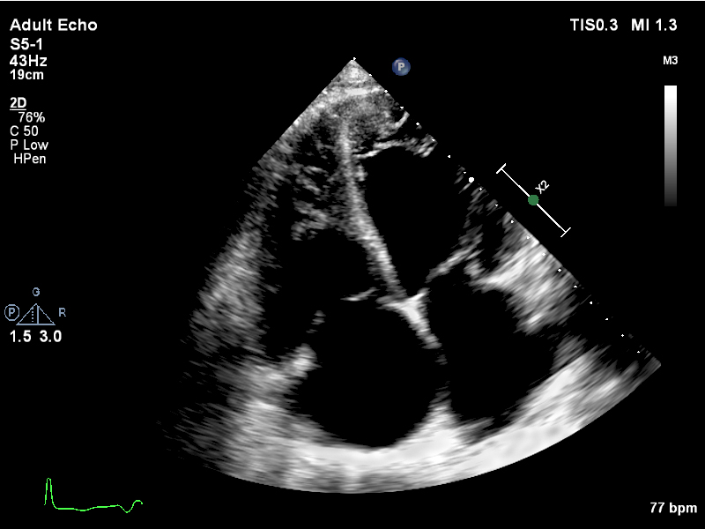
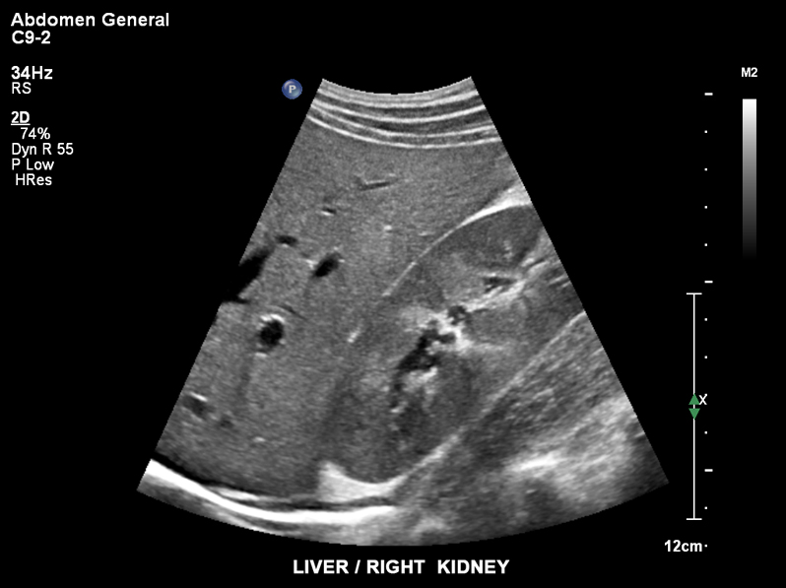
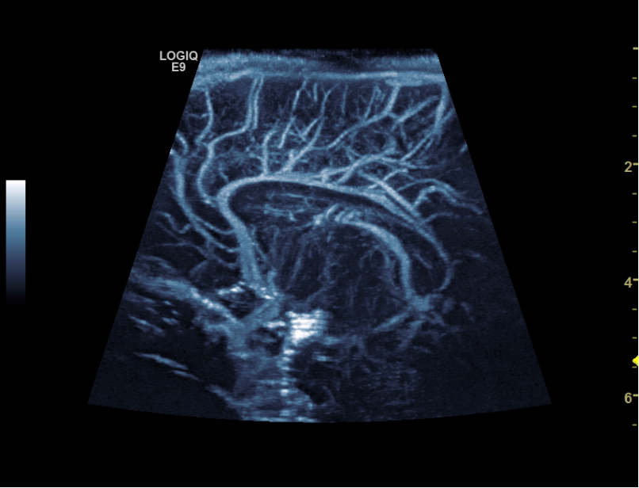
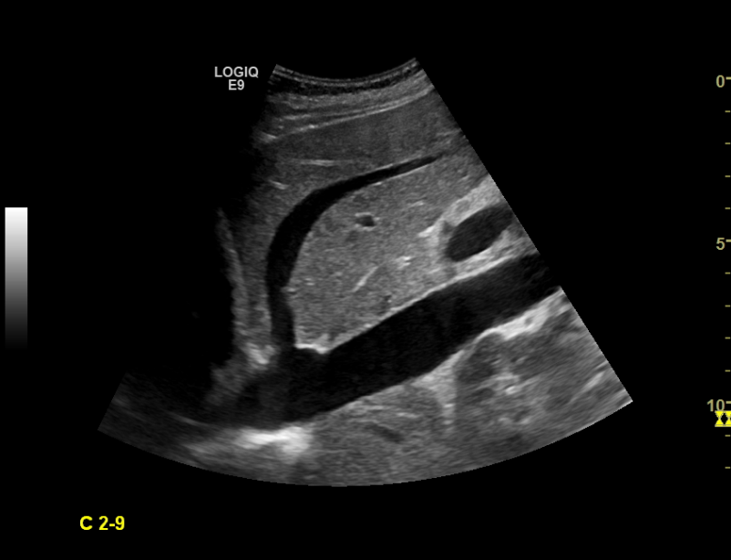
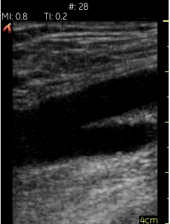
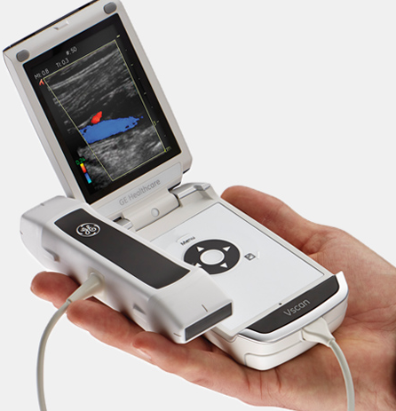
Adult Echocardiography
Neonate Brain Vasculature
IVC and Liver
Femoral Artery
(www.philips.com/healthcare)
(www.healthcare.siemens.com)
(www3.gehealthcare.com)

Slide 31
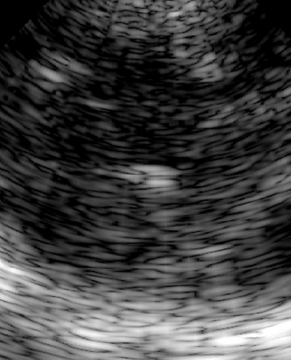
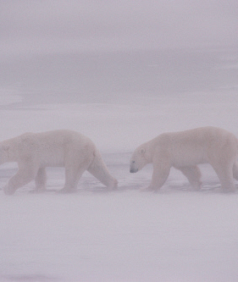
In Normal Patient Populations Ultrasound is Hard!
Clinical Failure Rates:
Ultrasound in vivo
Polar bears in
a blizzard
Obstetrics⁴⁻⁷ 11-64%
Cardiac TTE¹⁻³ 9-64%
TTE inadequate⁸ 98.4%
Tumor Detection Example:
(www.arcticphoto.co.uk)
[1] Flynn et al. Journal of cardiothoracic and vascular anesthesia, 2010.
[2] Garrett et al. Annals of vascular surgery, 2004.
[3] Heidenreich. Journal of the American College of Cardiology, 1995.
[4] Hendler et al. journal of the International Association for the Study of Obesity, 2004.
[5] Hendler et al. Journal of ultrasound in medicine, 2005.
[6] Hendler et al. American journal of obstetrics and gynecology, 2004.
[7] Khoury et al. The journal of maternal-fetal & neonatal medicine, 2009.
[8] Kurt et al., Journal of the American College of Cardiology, 2009.
[9] Ma et al. JVIR, 2010.
[10] Olszewski et al. European journal of echocardiography, 2007.
[11] Vijayaraghavan et al. Journal of clinical imaging science, 2011.
Intraoperative US detection -- 98% sensitivity
Transabdominal US detection 40-70%

Slide 32
Sources of Image Degradation
Pressure wave attenuation [1]
Diffraction-limitations [2,3]
Multiple scattering or reverberation (sometimes considered distinct) [2, 4, 5],
Gross sound-speed deviation[6]
Sound speed and attenuation inhomogeneities [7–13]
[1] Douglas Christensen. Ultrasonic Bioinstrumentation. John Wiley and Sons, New York, 1988.
[2] P L Carson and T V Oughton. A modeled study for diagnosis of small anechoic masses with ultrasound. Radiology, 122(3):765–71, March 1977.
[3] L. E. Hann, A. M. Bach, L. D. Cramer, D. Siegel, H. H. Yoo, and R. Garcia. Hepatic sonography: comparison of tissue harmonic and standard sonography techniques. AJR. American journal of roentgenology, 173(1):201–206, Jul 1999.
[4] S H P Bly, F S Foster, M S Patterson, D R Foster, and J W Hunt. Artifactual Echoes in B-Mode Images due to Multiple Scattering. Ultrasound Med. Biol., 11(1):99–111, 1985.
[5] Gianmarco F Pinton, Gregg E Trahey, and Jeremy J Dahl. Erratum: Sources of image degradation in fundamental and harmonic ultrasound imaging: a nonlinear, full-wave, simulation study. Ultrasonics, Ferroelectrics and Frequency Control, IEEE Transactions on, 58(6):1272–83, June 2011.
[6] Martin E Anderson and Gregg E Trahey. The direct estimation of sound speed using pulse-echo ultrasound. J. Acoust. Soc. Am., 104(5):3099–3106, November 1998.
[7] S.W. Smith, G.E. Trahey, and O.T. von Ramm. Phased array ultrasound imaging through planar tissue layers. Ultrasound Med. Biol., 12(3):229 – 243, 1986.
[8] L. M. Hinkelman, D. L. Liu, L. A. Metlay, and R. C. Waag. Measurements of ultrasonic pulse arrival time and energy level variations produced by propagation through abdominal wall. J. Acoust. Soc. Am., 95(1):530–541, Jan 1994.
[9] Makoto Tabei, T Douglas Mast, and Robert C Waag. Simulation of ultrasonic focus aberration and correction through human tissue. J. Acoust. Soc. Am., 113(2):1166–76, 2003.
[10] S W Flax and M O’Donnell. Phase-aberration correction using signals from point reflectors and diffuse scatterers: basic principles. Ultrasonics, Ferroelectrics and Frequency Control, IEEE Transactions on, 35(6):758–67, January 1988.
[11] Q. Zhu and B. D. Steinberg. Large-transducer measurements of wavefront distortion in the female breast. Ultrasonic imaging, 14(3):276–299, Jul 1992.
[12] Y. Sumino and R. C. Waag. Measurements of ultrasonic pulse arrival time differences produced by abdominal wall specimens. J. Acoust. Soc. Am., 90(6):2924–2930, Dec 1991.
[13] R.C. Waag, J.P. Astheimer, and Jr. Swartout, G. W. A characterization of wavefront distortion for analysis of ultrasound diffraction measurements made through an inhomogeneous medium. Sonics and Ultrasonics, IEEE Transactions on, 32(1):36–48, Jan 1985.

Slide 33
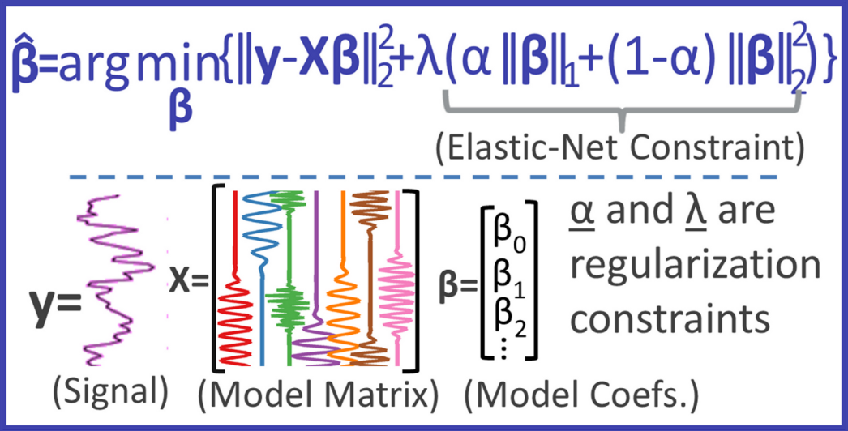
Beamforming as a Generic non-linear regression problem
With ADMIRE we posed ultrasound beamforming as a non-linear regression problem.
Given this, it opens up a wide range of possibilities
Deep Networks
Cluttered Channel Data In
…
DeclutteredData Out

Slide 34
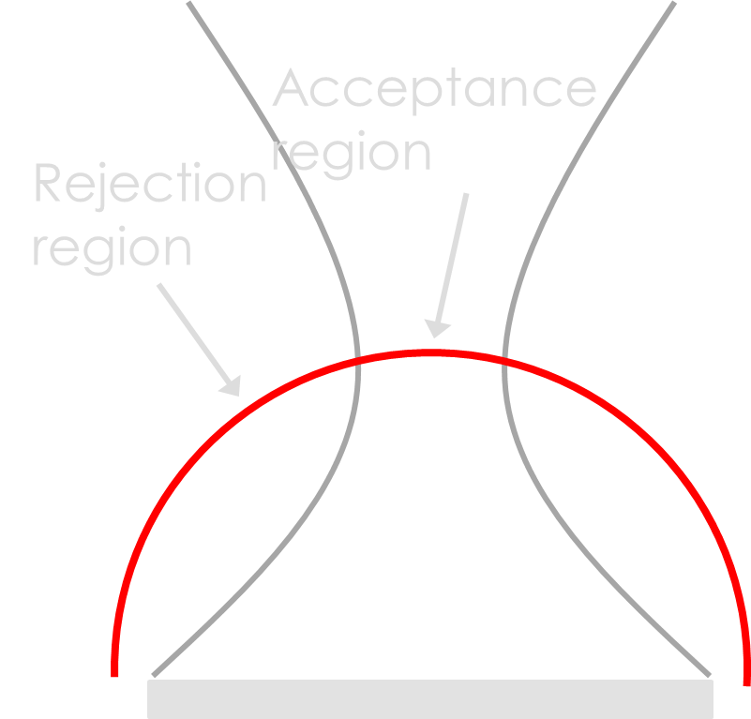
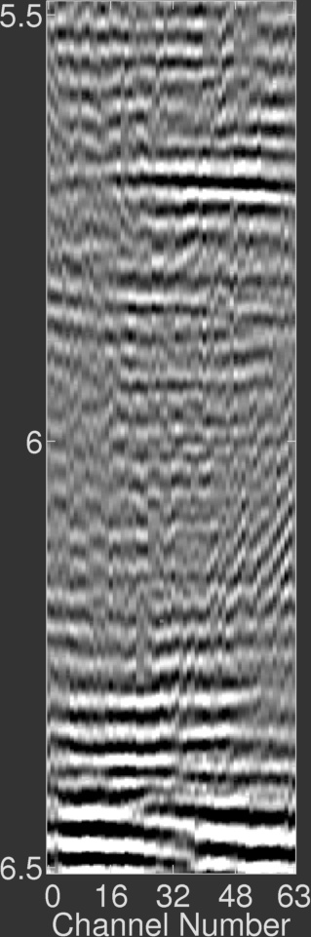
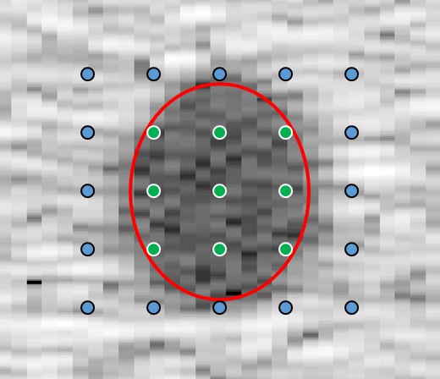
Deep Network Training with Sims
For ultrasound beamforming there are no curated data sets.
Single Scatterer Training
Depth (cm)
Many Scatterer Training

Slide 35
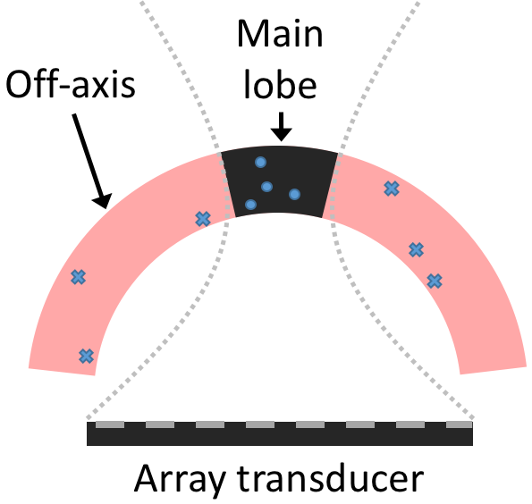
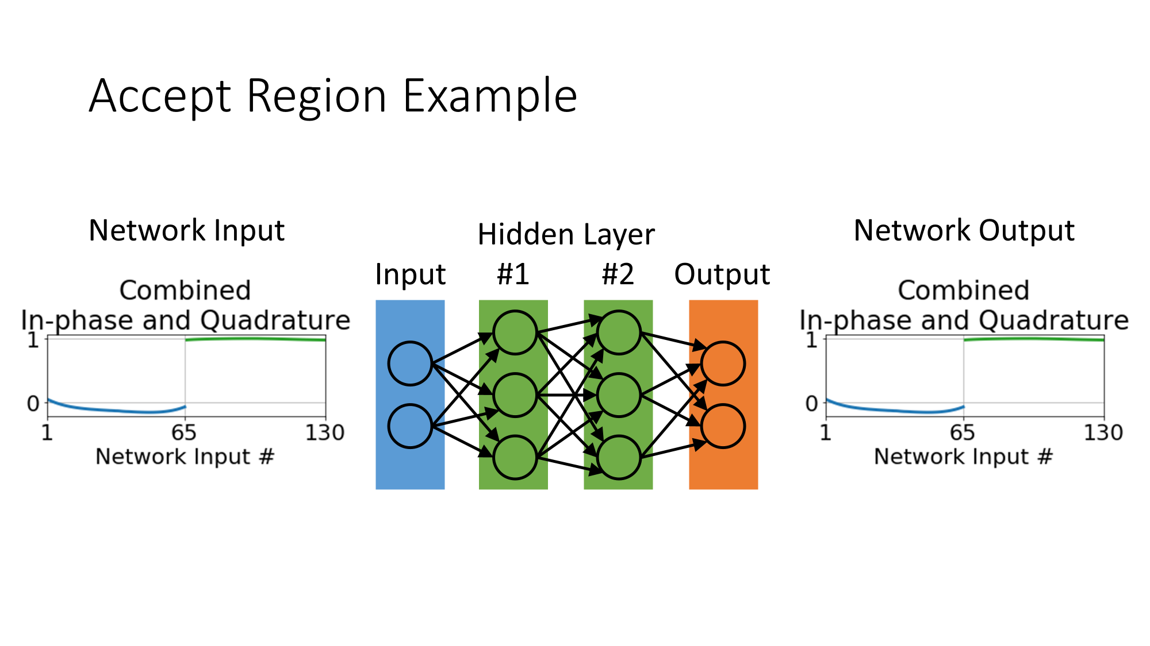
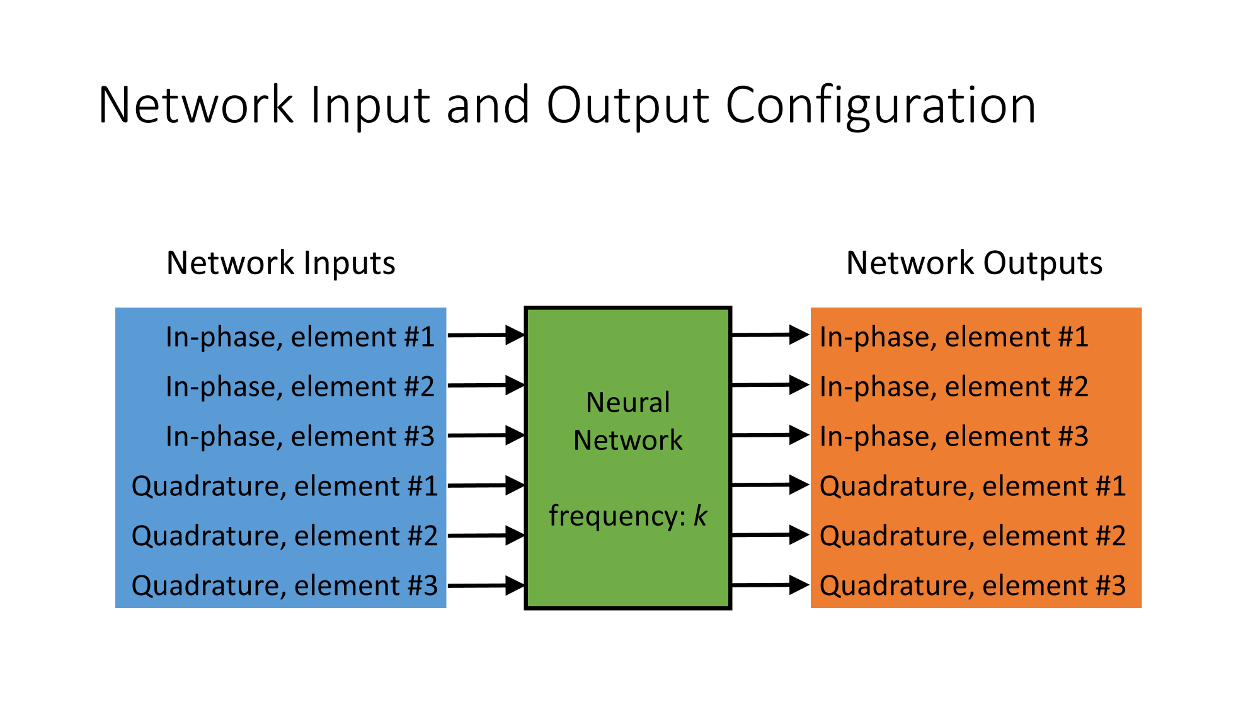
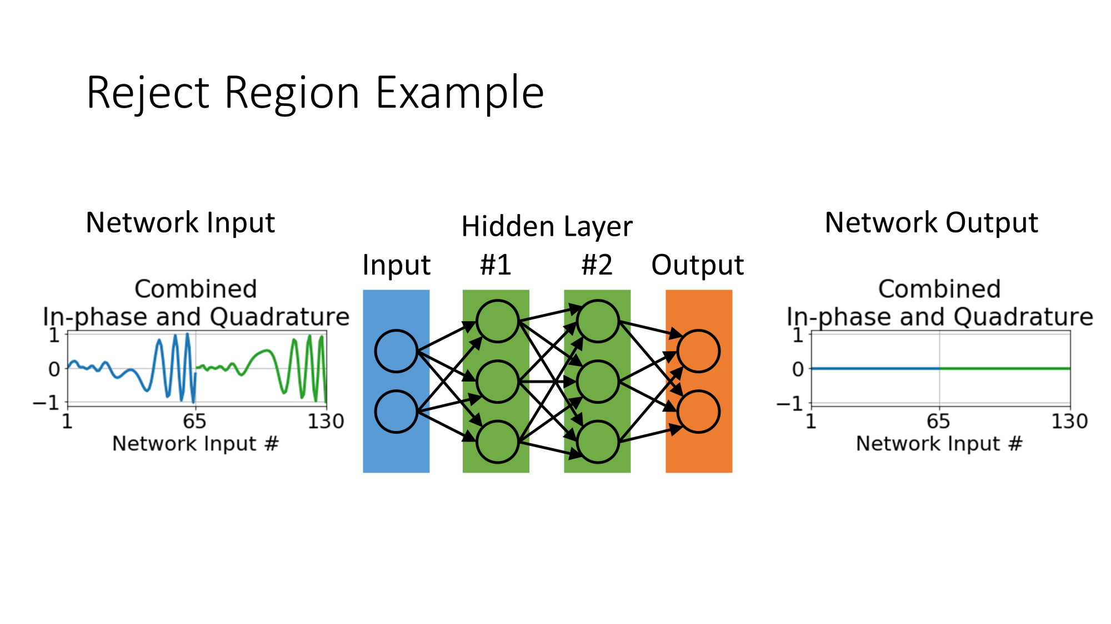
Neural Network Architecture

Slide 36
Neural Network Architecture
Accept Region

Slide 37
Neural Network Architecture

Slide 38
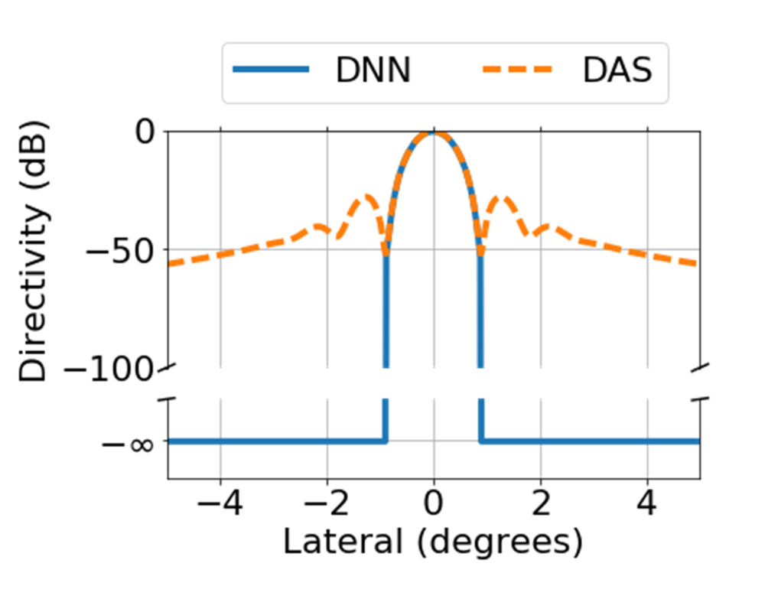
Best Example Network*
Architecture: Fully Conn.
Hidden layers: 7
Layer width: 1890
Learning rate: 1e-4
Learning rate decay: 1e-6
Dropout: 4e-3
Last layer dropout: False
Output layer bias: False
Weight initializations: He Normal
*At some point this was a “best” network

Slide 39
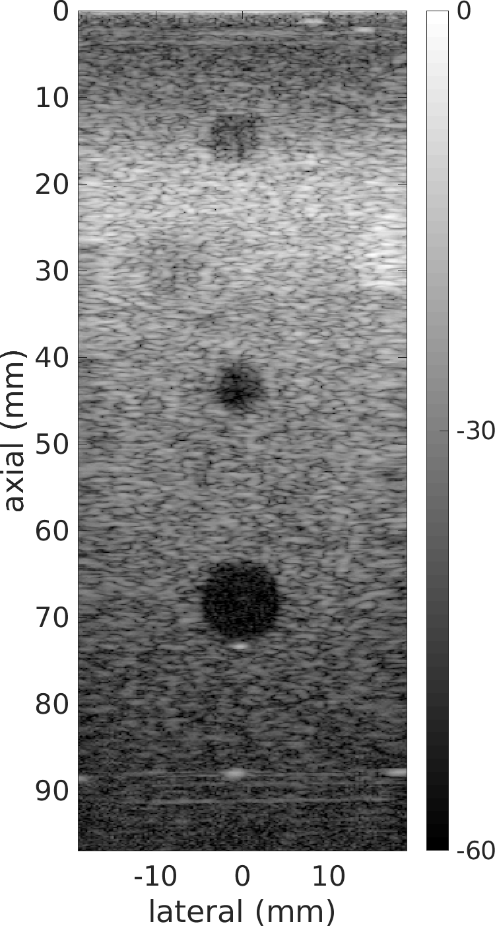
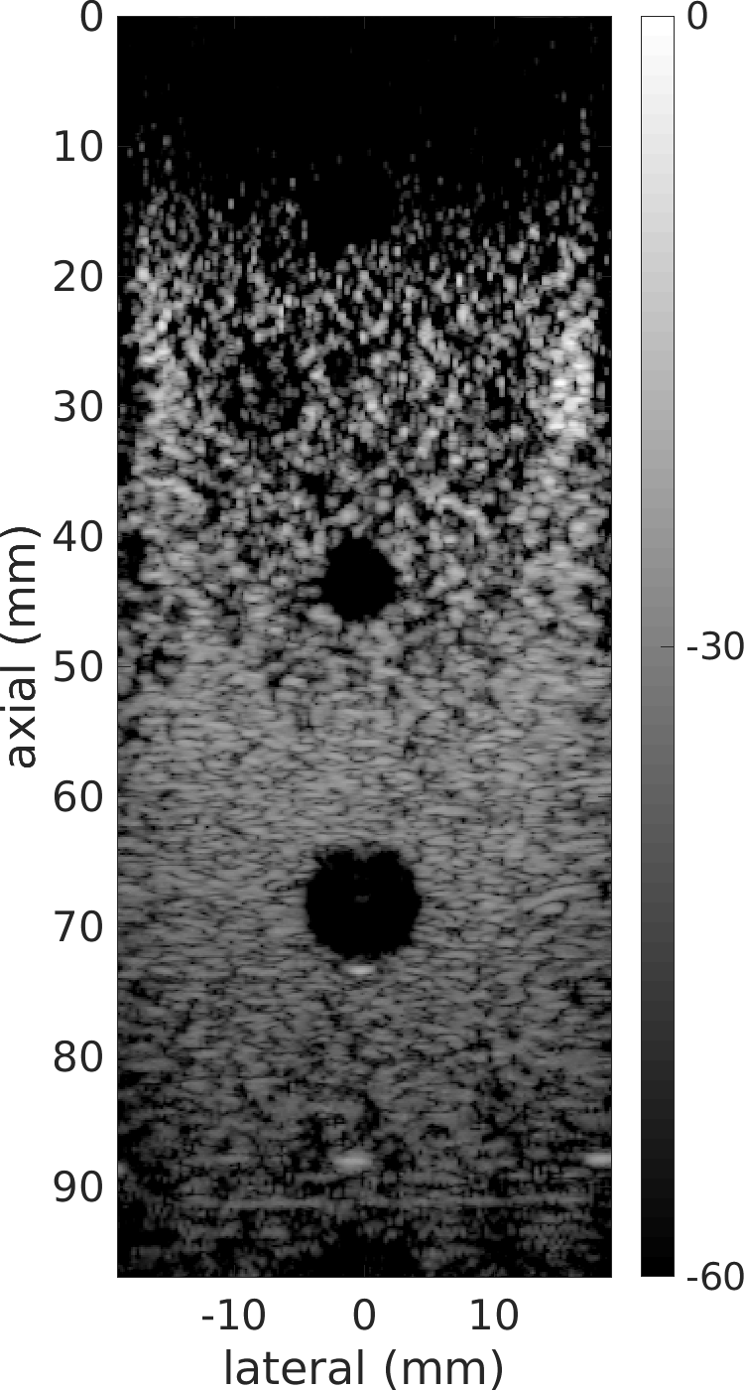
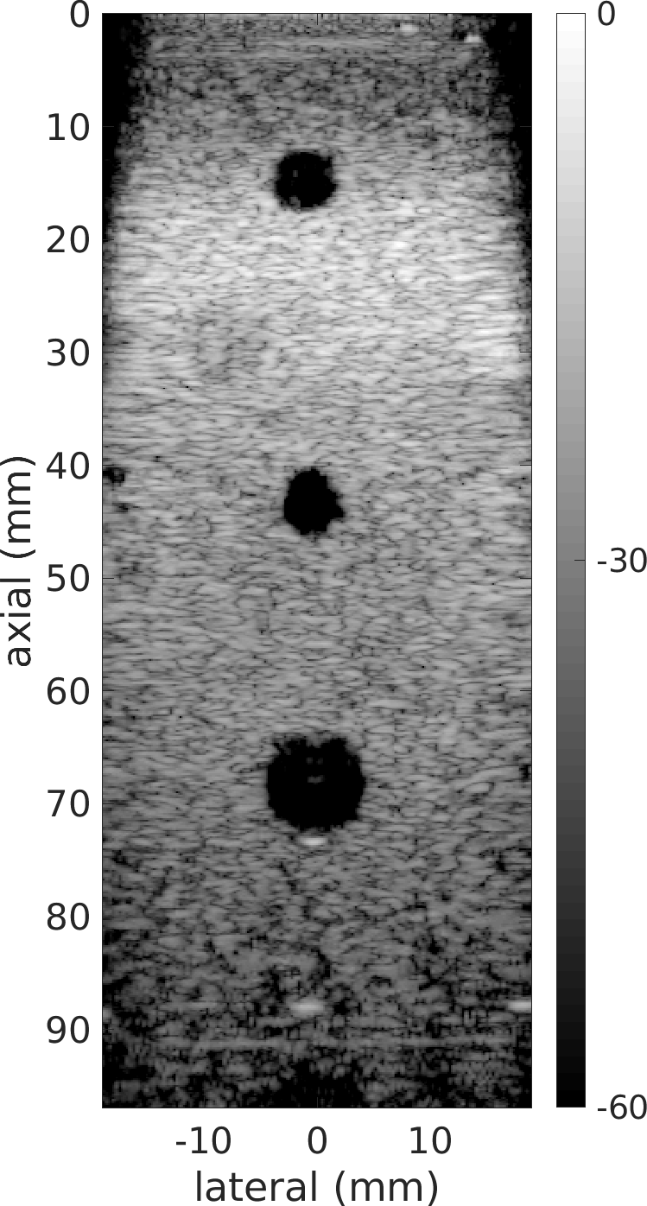
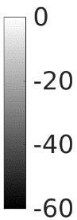
Does it work?
Great, but can we train with simulated data and apply it to data from an ultrasound system?
Deep Network
Train at
one depth
Train at
three depths
DAS
 | Depth: 15 mm (N=5)
 | CR (dB) | CNR (dB)
DAS | 13.0±1.1 | -0.8±0.2
DNN | 44.8±3.5 | 1.1±0.4
 | Depth: 45 mm (N=5)
 | CR (dB) | CNR (dB)
DAS | 16.4±0.8 | 3.2±0.3
DNN | 42.0±6.9 | 4.7±0.3
 | Depth: 70 mm (N=5)
 | CR (dB) | CNR (dB)
DAS | 19.0±0.4 | 3.0±0.2
DNN | 40.8±2.9 | 4.4±0.2
1 cm

Slide 40
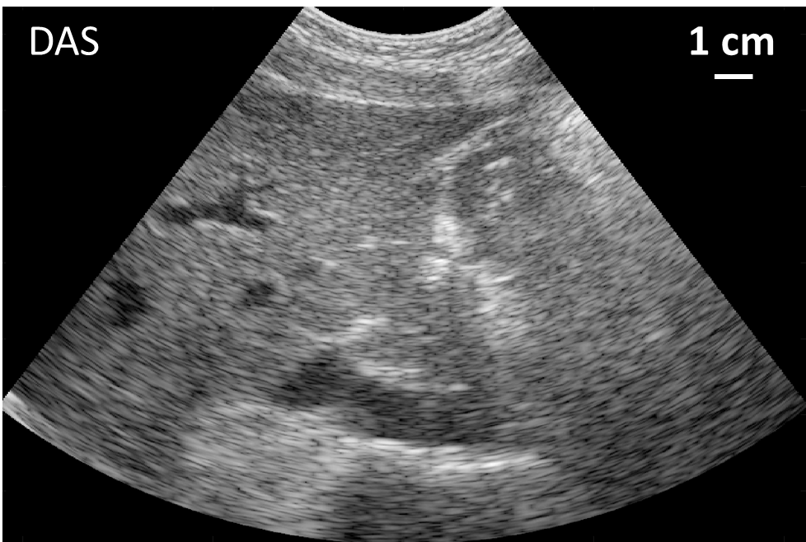
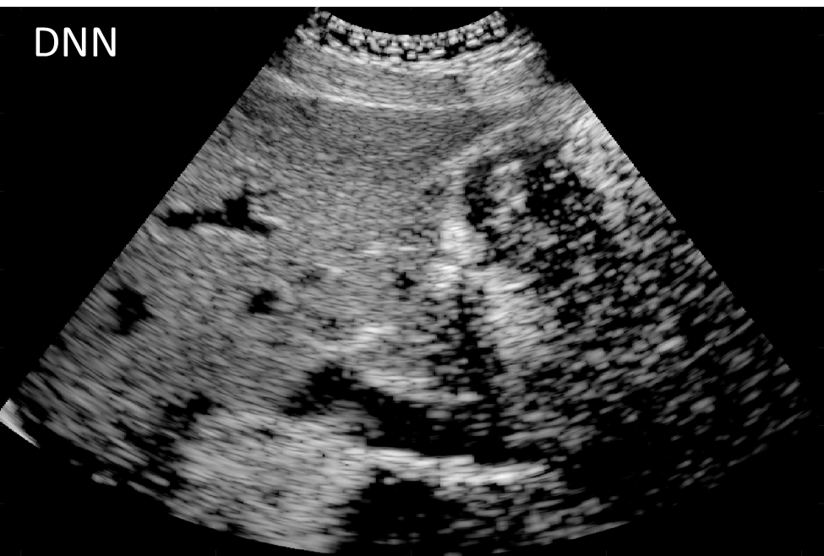
Does it translate?
N=6 | CR (dB) | CNR (dB)
DAS | 16.3±4.1 | 1.7±0.7
DNN | 31.0±6.9 | 3.2±1.1

Slide 41
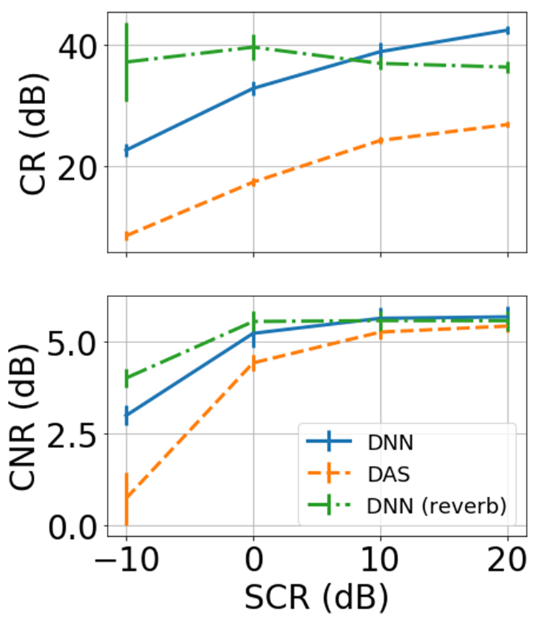
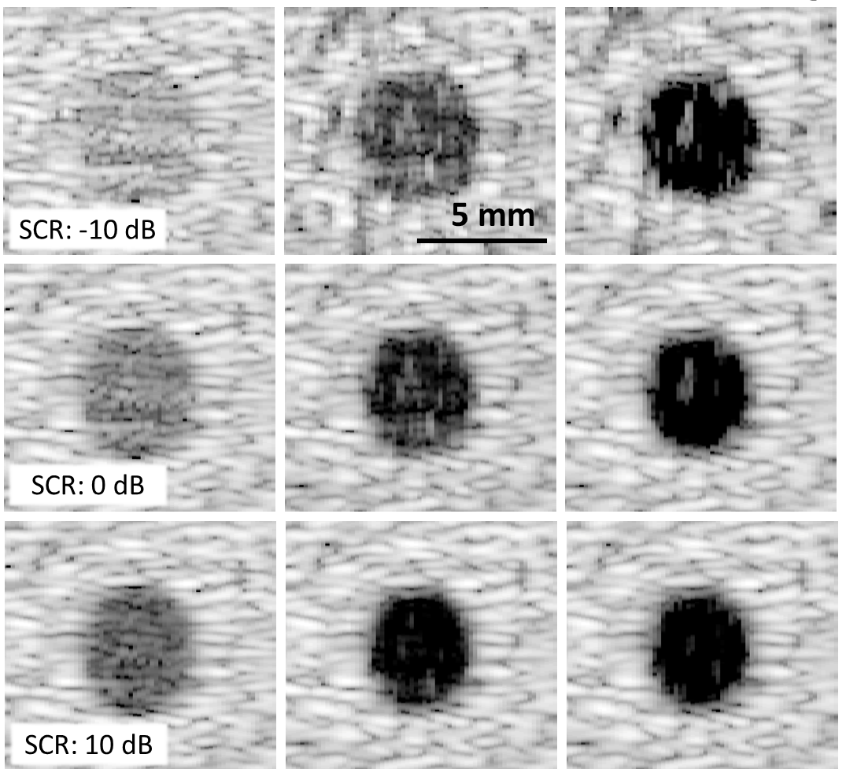
Where does it break?
Reverberation/Multipath Scattering
DNN with Reverb Training
DAS
DNN

Slide 42
Where does it break?
Reverberation/Multipath Scattering
DNN with Reverb Training
DAS
DNN

Slide 43
Okay—great, but are we reconstructing or classifying?
You can see a presentation we gave on this here: Adam C. Luchies, Brett C. Byram, "Improving B-mode target size estimation using DNN Beamforming (Conference Presentation)," Proc. SPIE 11319, Medical Imaging 2020: Ultrasonic Imaging and Tomography, 1131906 (17 March 2020); https://doi.org/10.1117/12.2549662

Slide 44
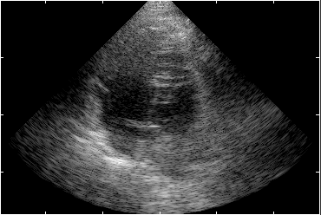
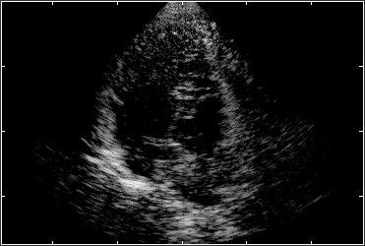
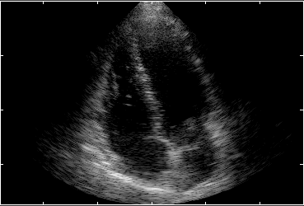
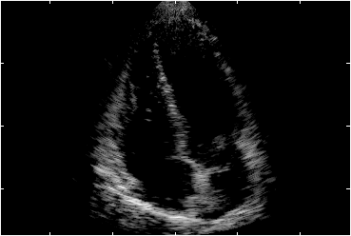
Further Examples
DAS
DNN
5 cm
5 cm

Slide 45
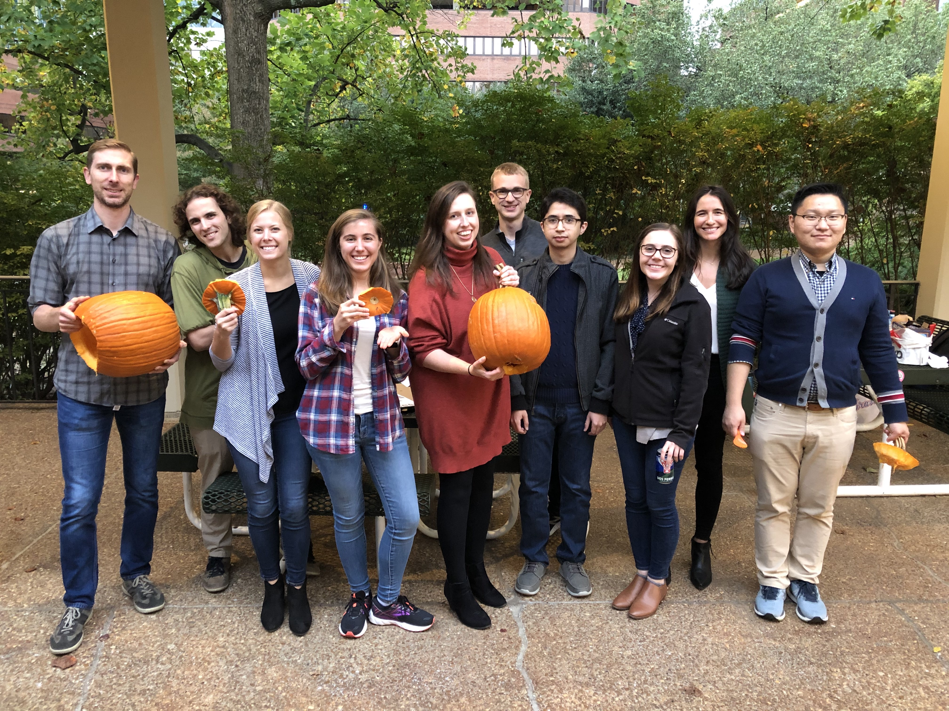
Acknowledgements
Dan Brown
Michael Miga
Ryan Hsi
Leon Bellan
Jason Mitchell
Ravi Duddu
Susan Eagle
Funding:
VISE Surgeon in Residence Program
VISE Seed Funding
NIH 1S10RR026828
NIH R01EB020040
NIH 1R35HL135790-01
NSF CAREER IIS-1750994
NIH UF1NS107666

Slide 46
Q&A at the end

